Slide 1

My Recent Research on
Multi-object Tracking（MOT）
A STORY OF MY NOTEBOOK
Fu Yuqian
October 12, 2018
赵梓豪
May 22, 2019

Slide 2
Outline
Statement of the logical architecture and main points
Experiments
MOT17 vs MOT19
Proposed Method
Recruitment & Schedule

Slide 3
Brief Introduction
Input
Images
Output
Trajectory
MOT method
Detections

Slide 4
Brief Introduction

Slide 5

1
Experiments

Slide 6
Experiments on MOT17/19
MOT17 | IDF1 | IDP | IDR | Rcll | Prcn | FAR | GT | MT | PT | ML | FP | FN | IDs | FM | MOTAL | MOTP | MOTA
MOTDT | 55.8 | 77.9 | 43.5 | 53.5 | 96.0 | 0.48 | 1638 | 303 | 772 | 563 | 7600 | 156496 | 1452 | 3625 | 51.3 | 82.7 | 50.9
Ours | 42.7 | 57.5 | 34.0 | 54.2 | 91.8 | 1.02 | 1638 | 342 | 729 | 525 | 16256 | 154156 | 5026 | 4594 | 49.4 | 82.3 | 47.9
~20fps
~0.6fps
MOT19 | IDF1 | IDP | IDR | Rcll | Prcn | FAR | GT | MT | PT | ML | FP | FN | IDs | FM | MOTAL | MOTP | MOTA
MOTDT | 40.9 | 58.9 | 31.4 | 49.3 | 92.5 | 5.52 | 2274 | 345 | 1371 | 558 | 49310 | 628631 | 6478 | 17570 | 45.3 | 86.5 | 44.8
Ours | 34.4 | 43.3 | 28.5 | 58.8 | 89.4 | 9.67 | 2274 | 588 | 1309 | 362 | 86353 | 510488 | 13228 | 17452 | 51.9 | 85.4 | 50.8
~4fps
~0.02fps
MOTDT可以代表18年MOT方法的最高水准，甚至在19年的开源方案里都是数一数二的。
为什么会在MOT19上远弱于我的方法？

Slide 7
Experiments on MOT17
DPM | IDF1 | IDP | IDR | Rcll | Prcn | FAR | GT | MT | PT | ML | FP | FN | IDs | FM | MOTAL | MOTP | MOTA
MOTDT | 50.3 | 76.0 | 37.6 | 46.7 | 94.5 | 0.58 | 546 | 72 | 245 | 229 | 3076 | 59838 | 388 | 1094 | 44.0 | 77.0 | 43.6
Ours | 31.9 | 47.0 | 24.2 | 44.9 | 87.4 | 1.37 | 546 | 71 | 222 | 239 | 7280 | 61848 | 1289 | 1123 | 38.4 | 75.8 | 37.3
FRCNN | IDF1 | IDP | IDR | Rcll | Prcn | FAR | GT | MT | PT | ML | FP | FN | IDs | FM | MOTAL | MOTP | MOTA
MOTDT | 55.5 | 79.0 | 42.7 | 51.8 | 95.7 | 0.49 | 546 | 95 | 267 | 184 | 2591 | 54169 | 442 | 1096 | 49.5 | 86.2 | 49.1
Ours | 49.6 | 66.2 | 38.4 | 53.7 | 92.5 | 0.93 | 546 | 111 | 257 | 163 | 4923 | 52008 | 1385 | 1315 | 49.3 | 87.1 | 48.1
SDP | IDF1 | IDP | IDR | Rcll | Prcn | FAR | GT | MT | PT | ML | FP | FN | IDs | FM | MOTAL | MOTP | MOTA
MOTDT | 61.1 | 78.4 | 50.1 | 62.2 | 97.3 | 0.36 | 546 | 136 | 260 | 150 | 1933 | 42489 | 622 | 1435 | 60.4 | 84.3 | 59.9
Ours | 46.9 | 58.0 | 39.3 | 64.1 | 94.7 | 0.76 | 546 | 160 | 250 | 123 | 4053 | 40030 | 2352 | 2156 | 60.5 | 82.9 | 58.4

Slide 8
Conclusion
MOT17数据设置不够合理，引导大家走向了一个不是很好的方向

Slide 9
2
MOT17 & MOT19

Slide 10
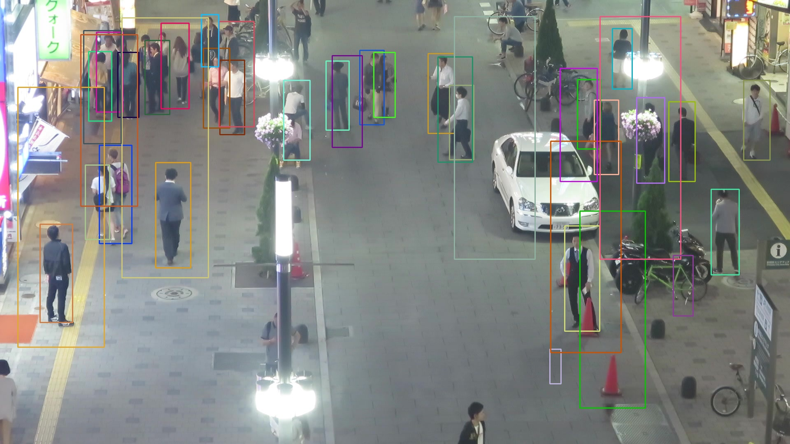
MOT17-04-DPM

Slide 11
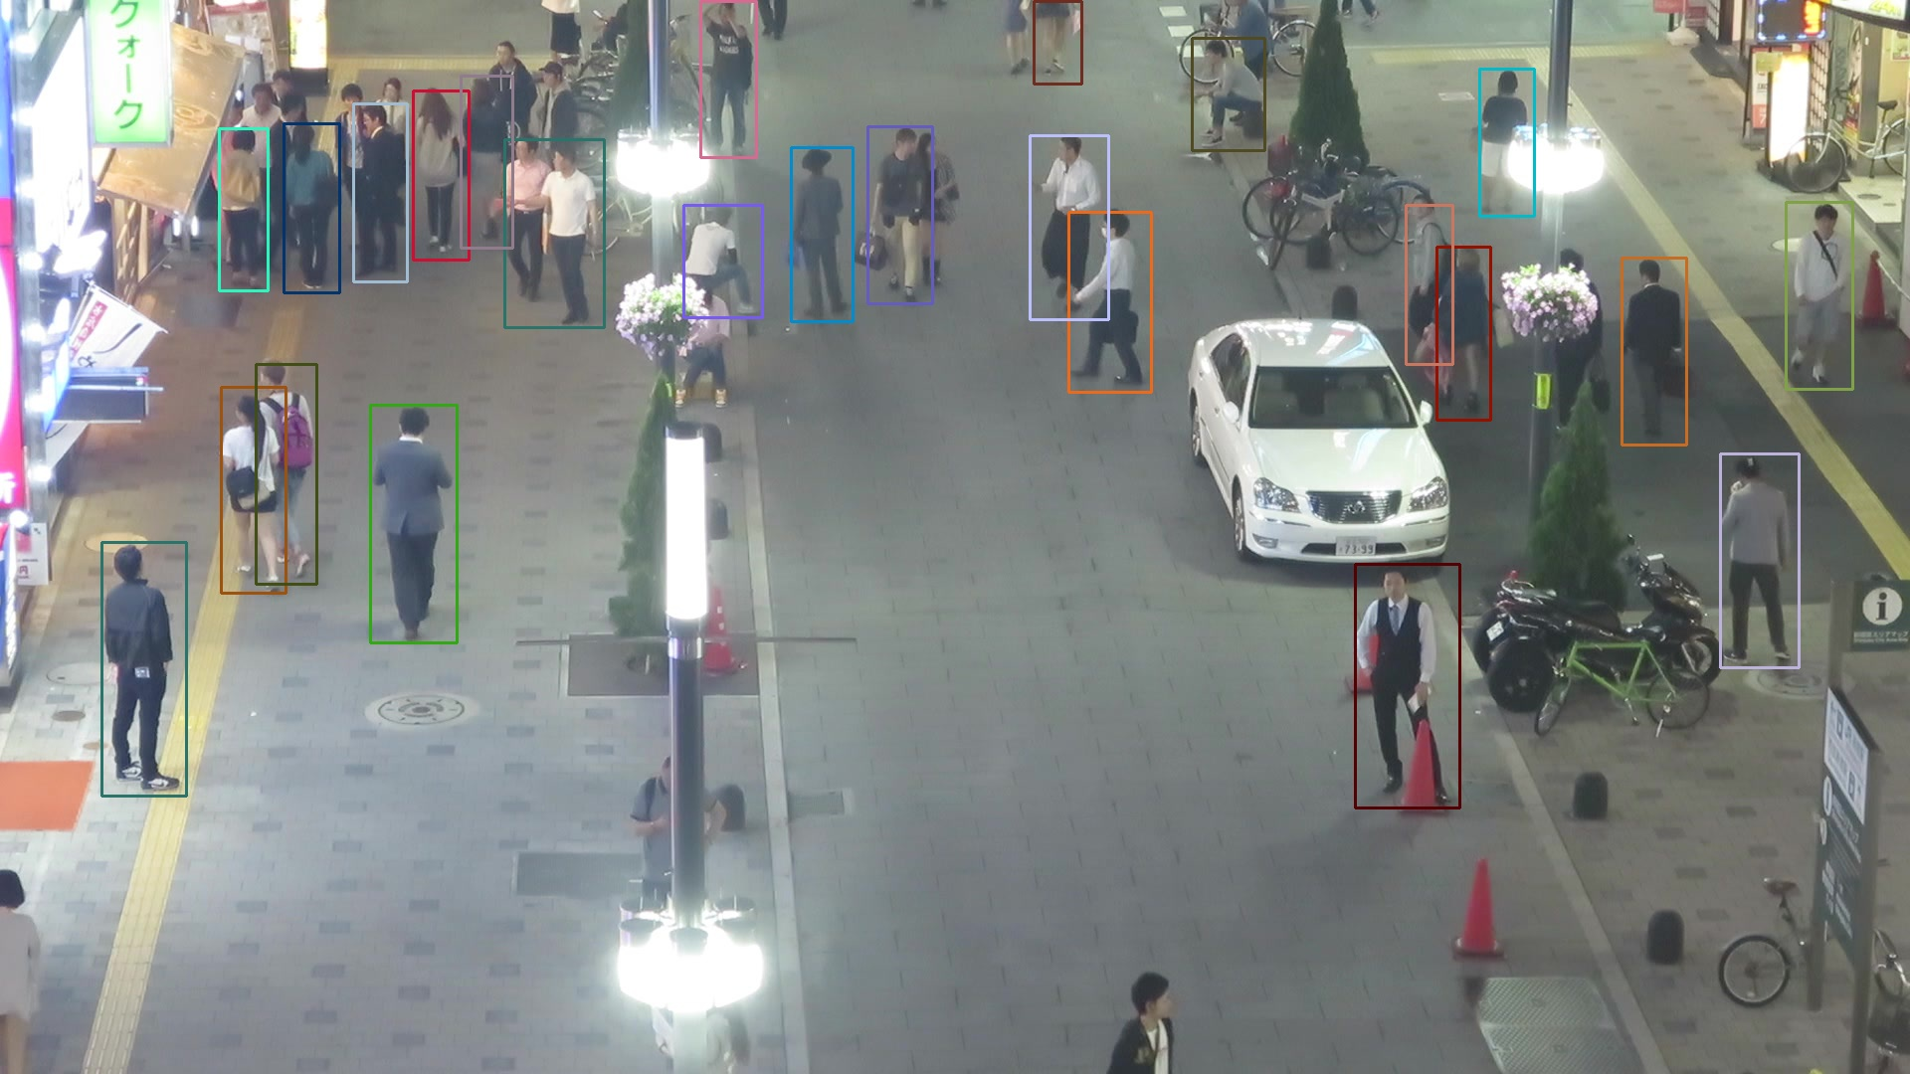
MOT19√
MOT17-04-FRCNN

Slide 12
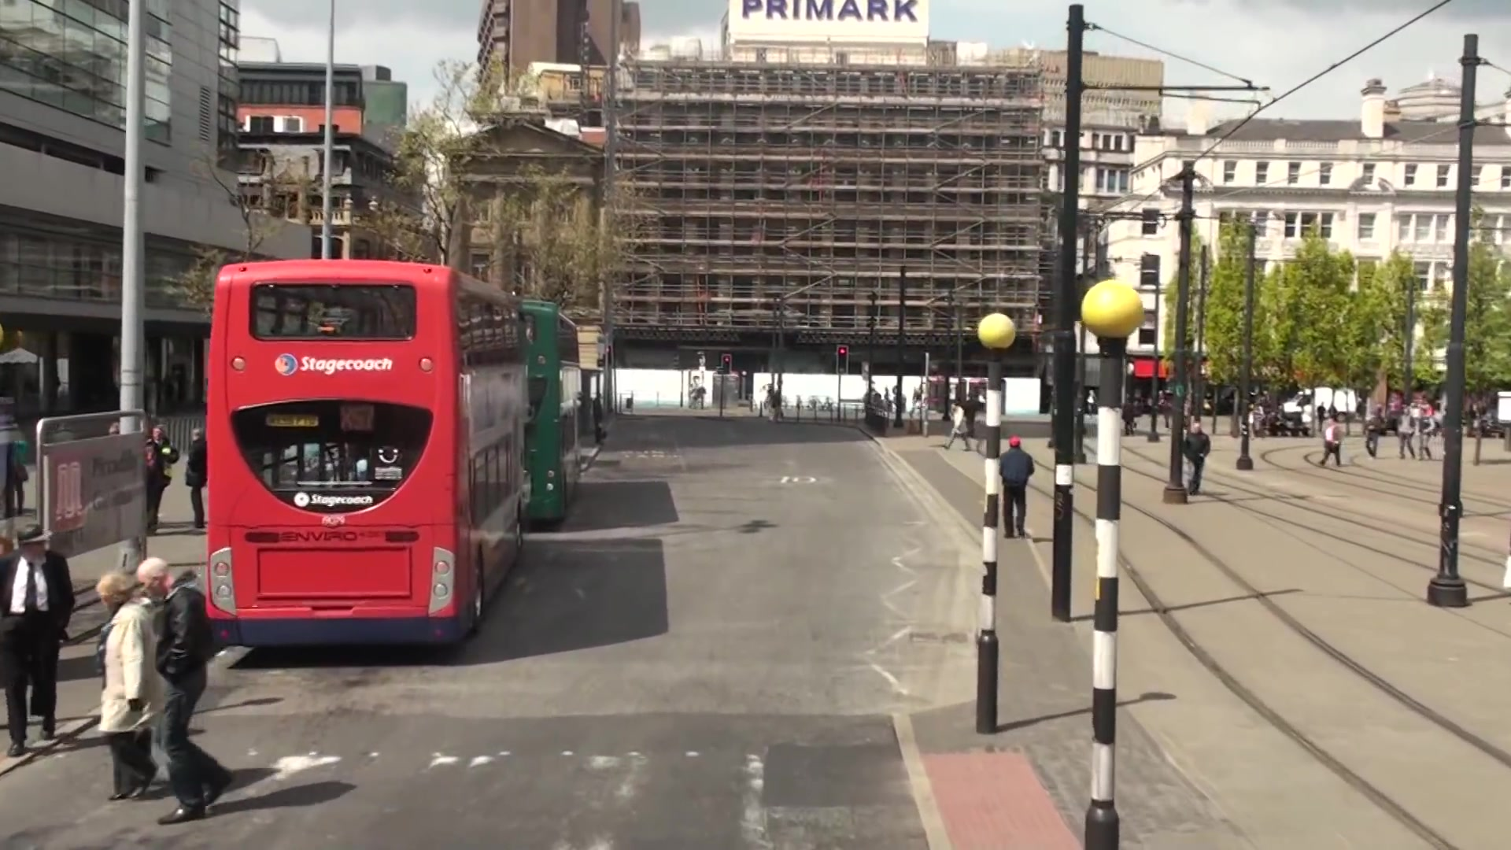
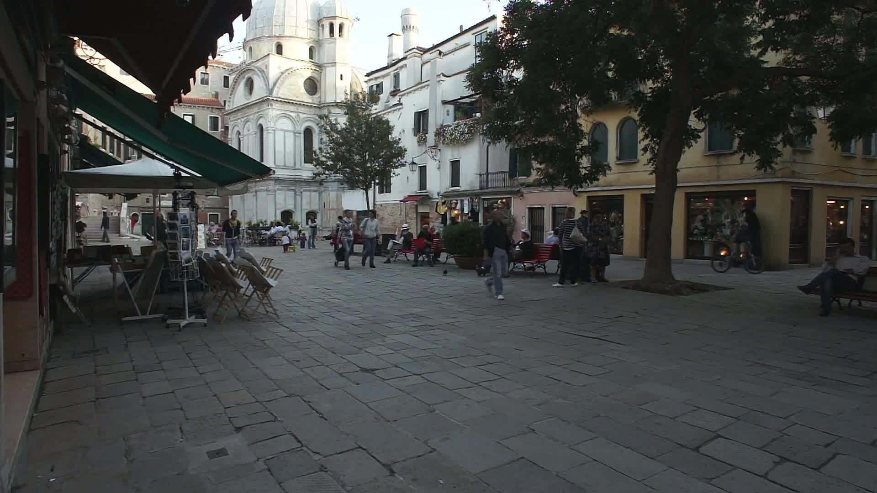
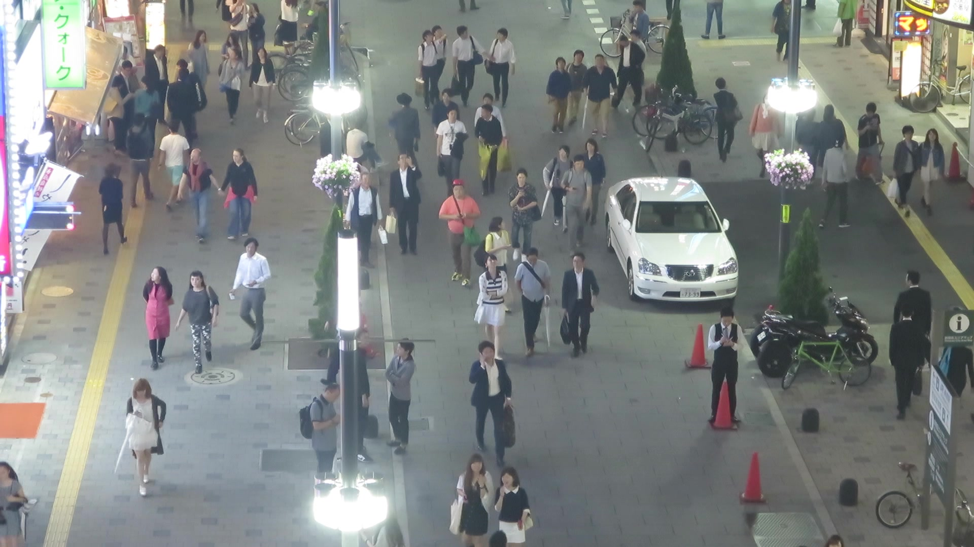
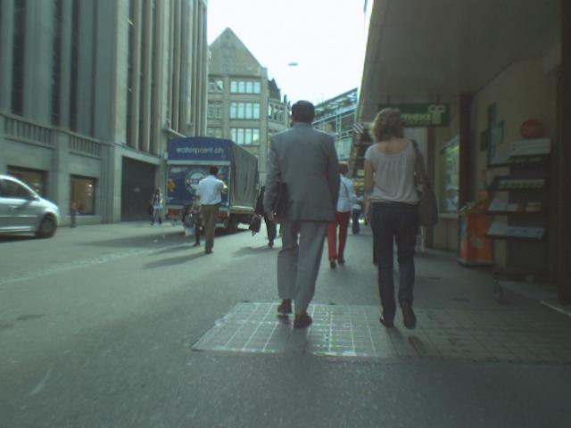
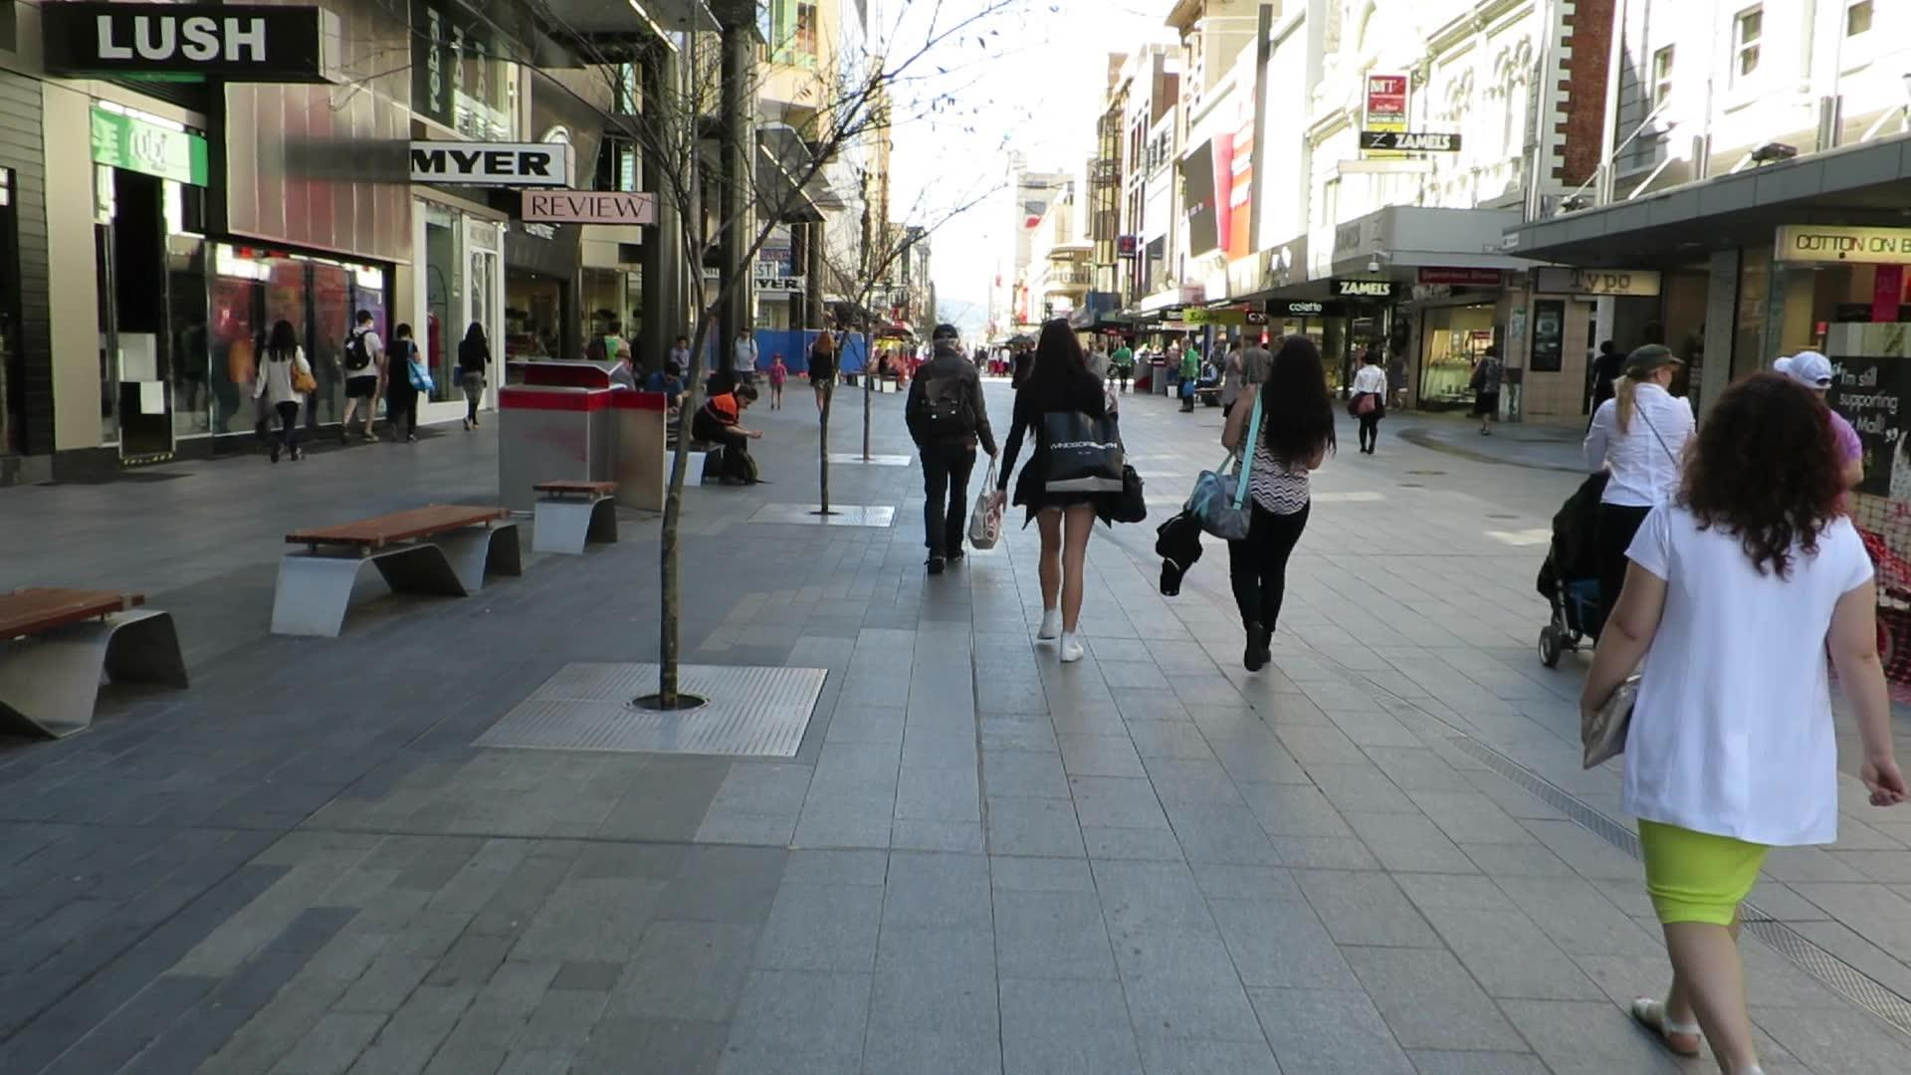

MOT17

Slide 13
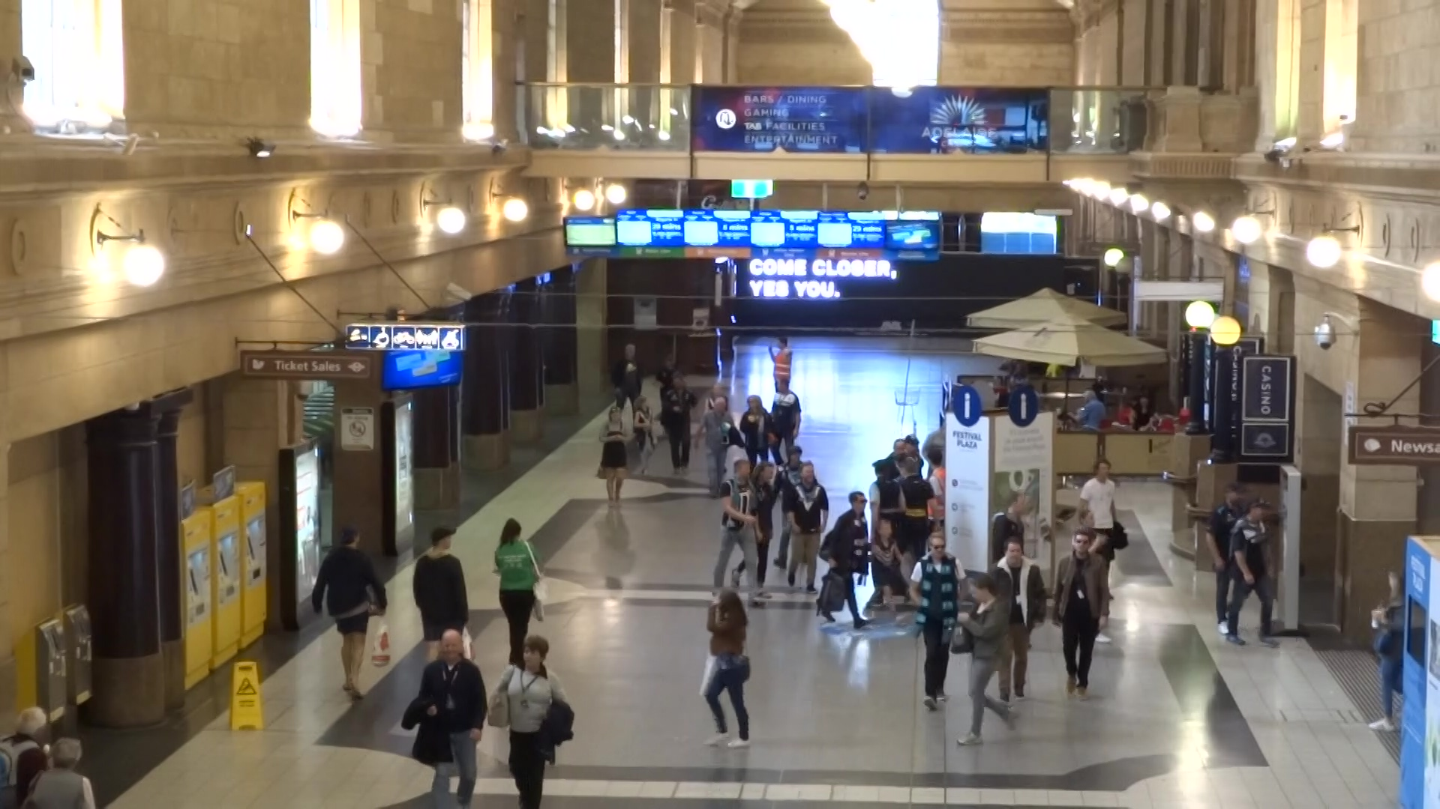
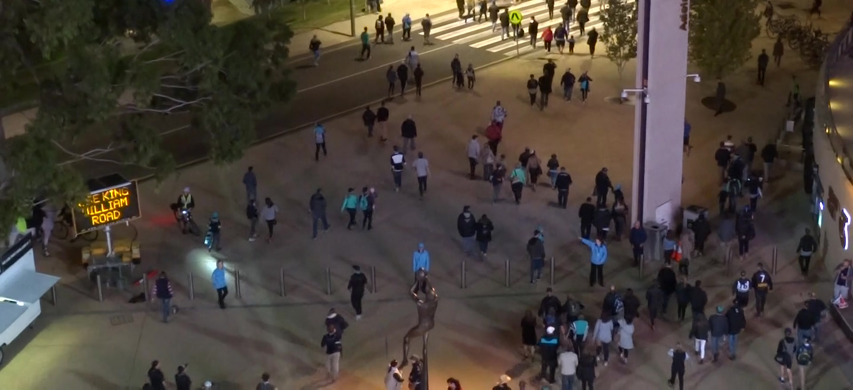
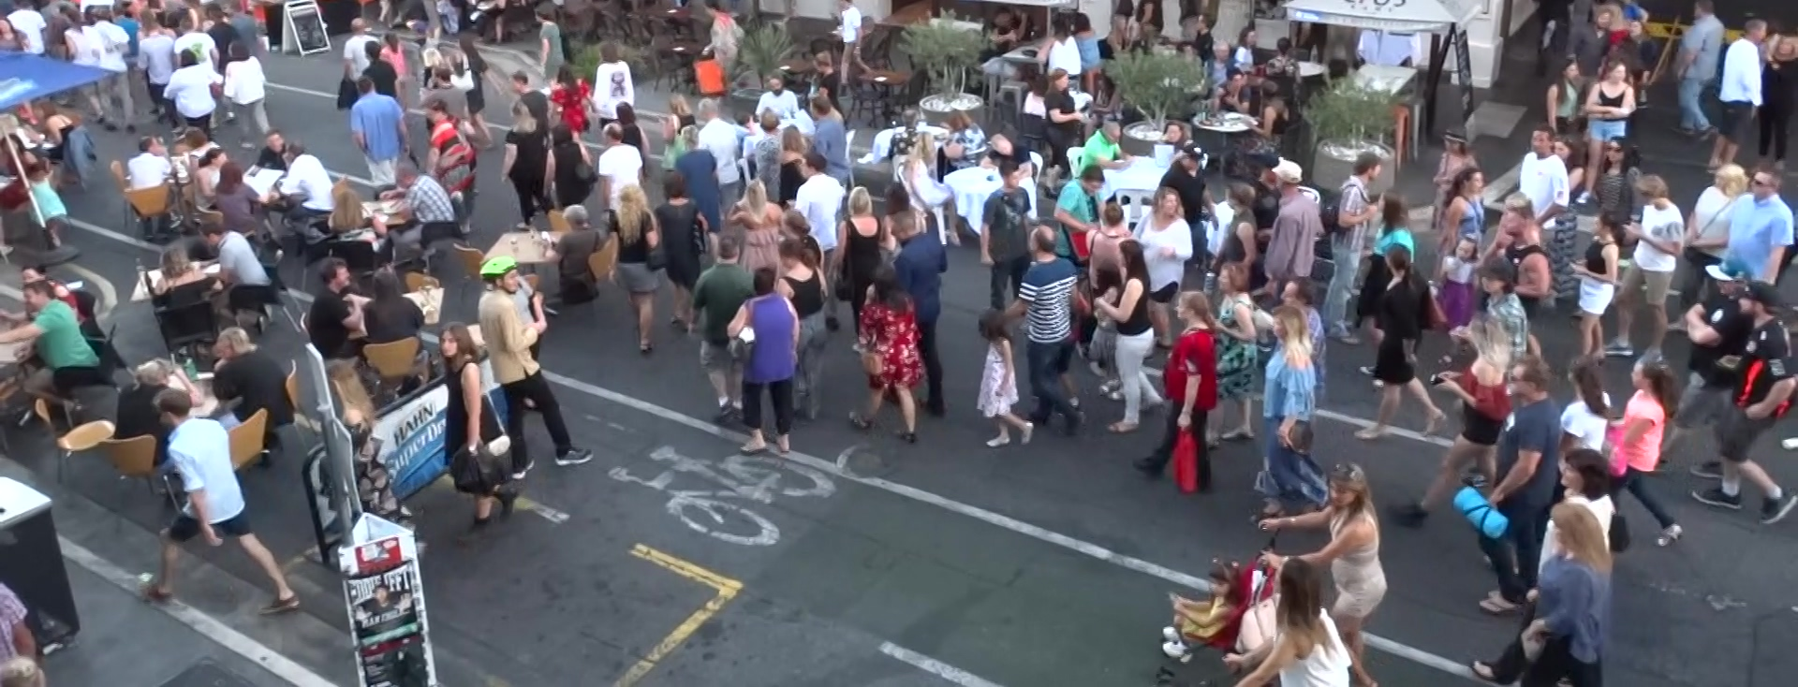
MOT19

Slide 14
MOT17 vs MOT19
Less scale variations
More crowded ~150p/f
Better detection boxes

Slide 15
3
Proposed Method

Slide 16
Analyze
Input your information here. Make it longer than the title..
Q
Why high-proformance but so slow on MOT19?
A
SOT is important but time-consuming!
理论对接
这里可以写清楚案例可以表达的理论，名称、概念、基本要素等等信息都可以写在这里。

Slide 17
Pipeline
SOT
KM algorithm
NMS
pedes_score
ReID
Lost
Input
Output
Image&
Detections
Trajectory

Slide 18
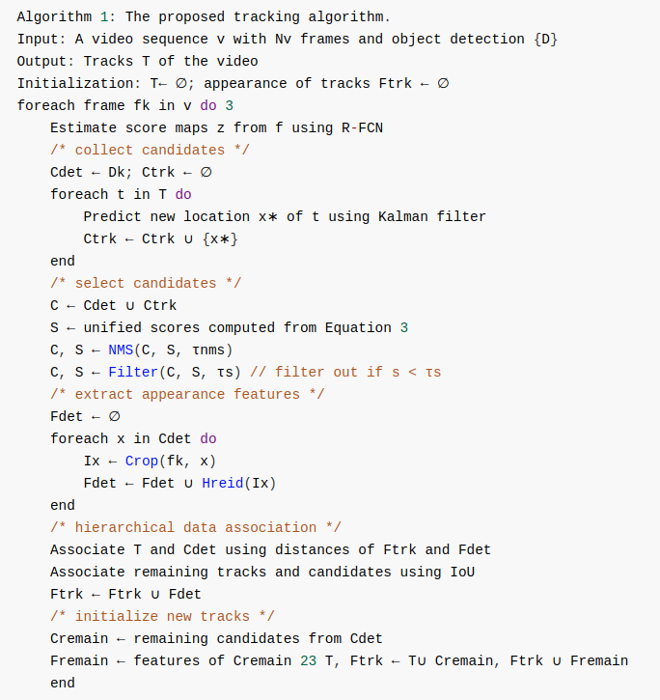
Pipeline

Slide 19
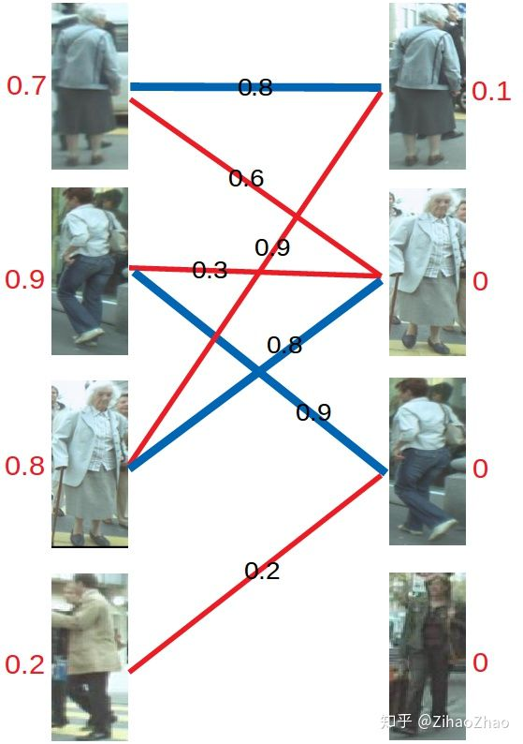
Pipeline
score
Position constrains
SOT & score
D = ReID(Det+SOT)
KM(D1,D2)

Slide 20
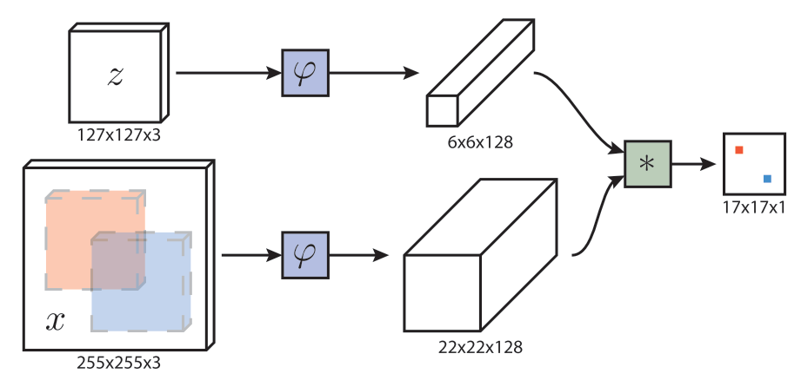
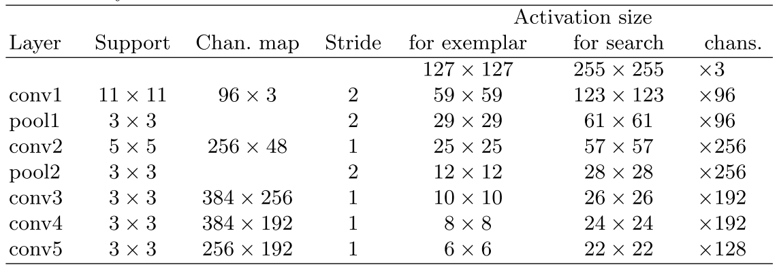
SiamFC

Slide 21
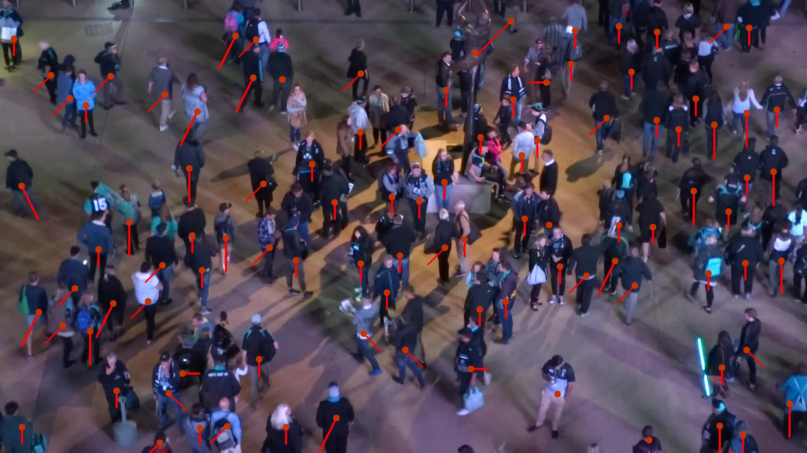
SiamMOT

Slide 22
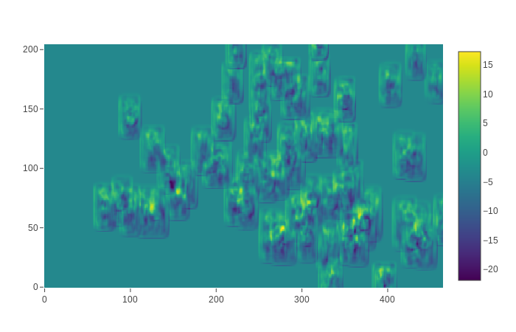
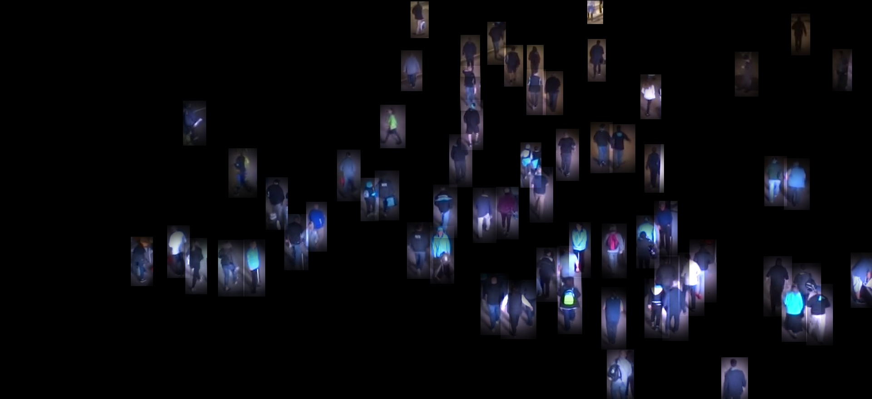
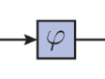
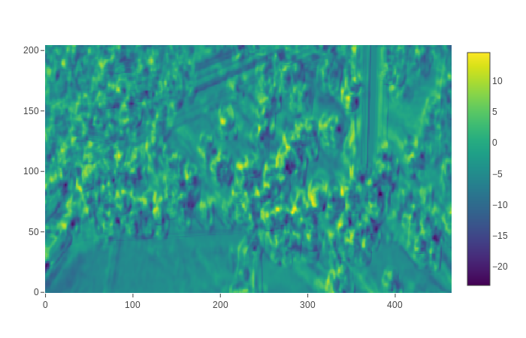
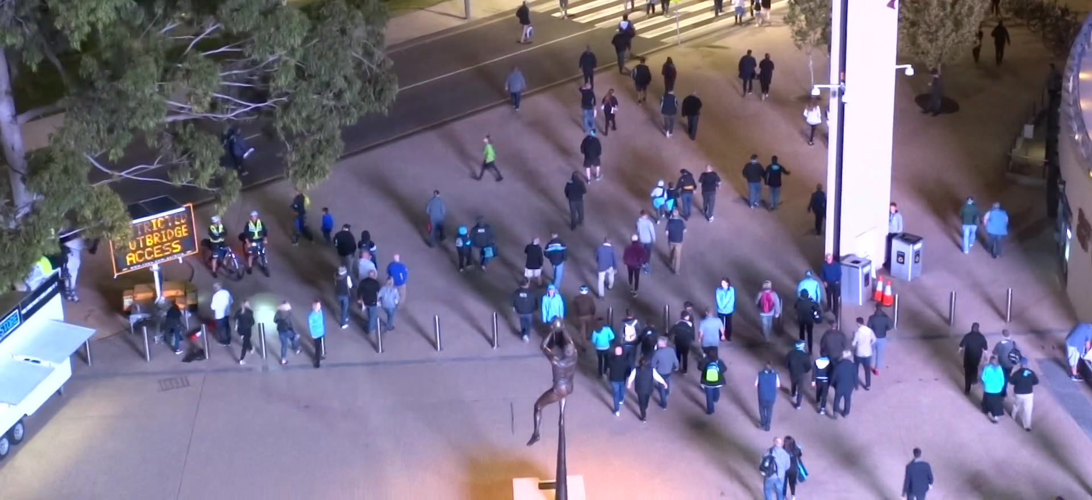
SiamMOT
1920*1080*3
465*255*32
1920*1080*3
465*255*32

Slide 23
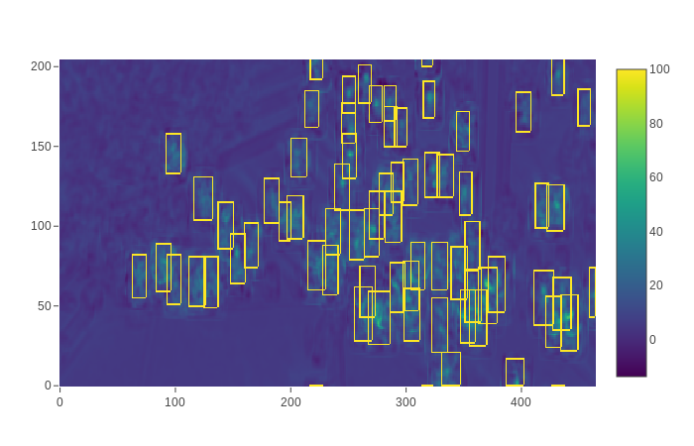
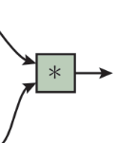
SiamMOT
由于物体位移，不能只在原位计算响应图。
对下一帧整帧进行循环位移，计算不同位移量时，框内响应值求和，取响应值最高的位移量即为物体位移。
465*255*32
np.roll
465*255*32
465*255*32

Slide 24
4
Schedule & Recurit

Slide 25
Schedule
Time Nodes |  | Duration
20190220 | 初步决定MOT方向
20190228 | 整理MOT综述，做组会报告。 | 1 week
20190304 | 立下Flag，在九月的AAAI发MOT。 | 1 week
20190320 | 完成前期理论储备，开始动手实验。 | 3 weeks
20190403 | 第一阶段实验，尝试统一框架，失败 | 2 weeks
20190417 | 第二阶段实验，从ReID入手，先完成简单MOT框架，基本完成目标 | 2 weeks
20190428 | 写文章总结，同时完善自己的知识结构。 | 1 weeks
20190508 | 第三阶段实验，目标使自己的代码基本达到18SOTA水准。 | 1 weeks
20190522 | 第四阶段实验，SiamMOT | 1 weeks
…… | …… | 3 months
20190905 | AAAI 2020 Deadline

Slide 26
Recruitment
跑代码on MOT19
图结构（帧内）
使用NLP方法预测行人轨迹（帧间）

Slide 27
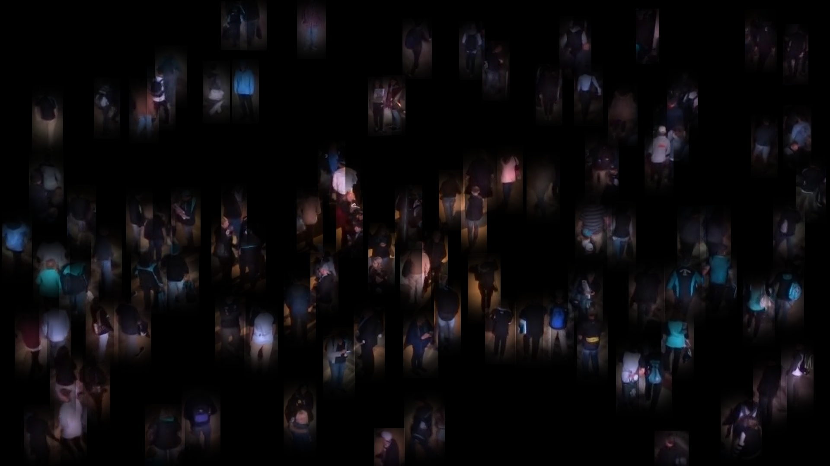
How to Build a Graph?

Slide 28
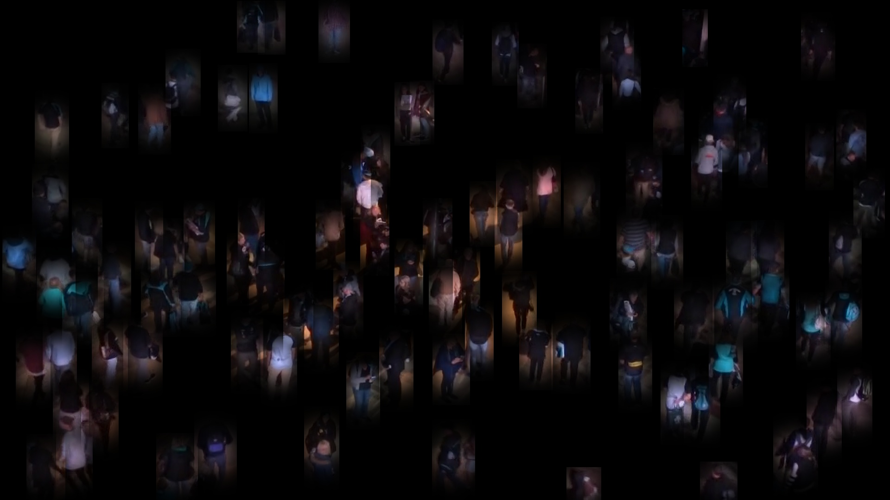
How to Build a Graph?

Slide 29

How to Build a Graph?

Slide 30

How to Build a Graph?

Slide 31
THANKS

